Slide 1
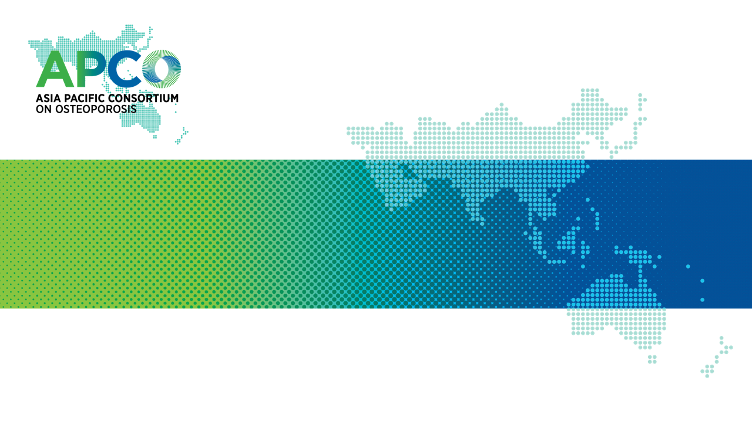
DEVELOPMENT OF THE APCO FRAMEWORK – Clinical standards for the screening, diagnosis & management of osteoporosis in the Asia-Pacific region
M Chandran, PJ Mitchell, T Amphansap, SK Bhadada, M Chadha, DC Chan, YS Chung, P Ebeling, N Gilchrist, A Habib Khan, P Halbout, Hew FL, LT Ho-Pham, Lau TC, Lee JK, S Lekamwasam, G Lyubomirsky, LB Mercardo-Asis, A Mithal, TV Nguyen, D Pandey, I Reid, A Suzuki, TT Chit, Tiu KL, T Valleenukal, Yung CK, Zhao YL, on behalf of the Asia Pacific Consortium on Osteoporosis (APCO)
Osteoporos Int 2021; online head of print. https://doi.org/10.1007/s00198-020-05742-0

Slide 2
The APCO Membership
Executive Committee
Dr. Manju Chandran, APCO Chairperson, Singapore, Singapore
Dr. Greg Lyubomirsky, Sydney, Australia
Professor Peter Ebeling, Melbourne, Australia
Professor Tuan Nguyen, Sydney, Australia
Professor Weibo Xia, Beijing, China
Dr Tiu Kwok Leung, Hong Kong, Hong Kong SAR
Professor Sanjay K Bhadada, Chandigarh, India
Dr Nigel Gilchrist, Christchurch, New Zealand
Dr. Aysha Habib Khan, Karachi, Pakistan
Professor Sarath Lekamwasam, Matara, Sri Lanka
Dr Philippe Halbout, Nyon, Switzerland
Dr Cae Tolman, Hong Kong, Hong Kong SAR (non-voting)
Paul Mitchell, Auckland, New Zealand (non-voting)
APCO Members
Dr Yung Chee Kwang, Brunei Darussalam
Dr Zhao Yanling, Beijing, China
Professor Liu Jianmin, Shanghai, China
Professor Ding-Chen Chan, Taipei, Chinese Taipei
Dr Edith Lau, Hong Kong, Hong Kong SAR
Professor Ambrish Mithal, New Delhi, India
Professor Manoj Chadha, Mumbai, India
Dr Gunawan Tirtarahardja, Jakarta, Indonesia
APCO Members (continued)
Professor Akira Taguchi, Nagano, Japan
Professor Atsushi Suzuki, Toyoake, Japan
Dr Hew Fen Lee, Puchong, Malaysia
Dato’ Dr Lee Joon Kiong, Petaling Jaya, Malaysia
Dr Tet Tun Chit, Yangon, Myanmar
Professor Tint Swe Latt, Yangon, Myanmar
Dr Dipendra Pandey, Kathmandu, Nepal
Professor Ian Reid, Auckland, New Zealand
Professor Leilani B Mercado-Asis, Manila, Philippines
Professor Yoon-Sok Chung, Suwon, Republic of Korea
Dr Dong Ock Lee, Goyang, Republic of Korea
Professor Kee Hyung Rhyu, Seoul, Republic of Korea
Dr Lau Tang Ching, Singapore, Singapore
Dr Tanawat Amphansap, Bangkok, Thailand
Dr Thanut Valleenukul, Bangkok, Thailand
Associate Professor Vu Thanh Thuy, Hanoi, Vietnam
Dr Lan T Ho-Pham, Ho Chi Minh City, Vietnam

Slide 3
Outline
Background
Comparative analysis of osteoporosis guidelines in the Asia Pacific
Consensus process for developing the clinical care standards framework
The APCO Framework
Application of the Framework to clinical practice guidelines

Slide 4
The aging population and increasing fracture burden
3x increase in people aged ≥ 60 years in Asia by 2050, compared to 2010¹
Several countries in Asia will have the highest old-age dependency ratios (OADRs) in the world in 2050²
OADR: the number of persons aged 65 years or over (assumed to be economically inactive) per 100 persons of working age (20 to 64 years).
Over 50% of all osteoporotic hip fractures will occur in Asia Pacific by the year 2050³
Osteoporosis is greatly underdiagnosed and undertreated in Asia Pacific
Even in the most high-risk patients who have already fractured are not treated.^{4,5}
From World Population Prospects: Volume II: Demographic Profiles 2017 Revision. ST/ESA/SER.A/400,by Department of Economic and Social Affairs, Population Division, ©2017 United Nations. Reprinted with the permission of the United Nations.
1. United Nations Population Fund (UNFPA) Asia and the Pacific (2020) Ageing [web page]. UNFPA Asia and the Pacific. https://asiapacific.unfpa.org/en/node/15208 Accessed November 2020 ; 2. United Nations Department of Economic and Social Affairs Population Division (2019) World population ageing 2019. Highlights. United Nations, New York; 3. Cheung et al. Osteo Sarc 2018; 4:16–21; 4. Yeap SS et al. Osteoporos Sarcopenia 2017;3:161-63; 5. Australia and New Zealand Hip Fracture Registry. ANZHFR Annual Report of Hip Fracture Care 2019. https://anzhfr.org/wp-content/uploads/2019/09/2019-ANZHFR-Annual-Report-FINAL.pdf. Accessed 27 March 2020.
Notes:
Speaker notes:
The number of people who are 60 years and over in the Asia-Pacific region is predicted to triple between 2010 and 2050.¹
Several countries in Asia will have the highest old-age dependency ratios (OADRs) in the world in 2050²
The old-age dependency ratio (OADR), is defined as the number of persons aged 65 years or over (assumed to be economically inactive) per 100 persons of working age (20 to 64 years). It provides an index of the economic dependency associated with aging populations and, is expected to nearly triple in Eastern and South-Eastern Asia between 2010 and 2050.¹
Osteoporotic hip fractures among people in the Asia Pacific region are expected to increase dramatically due to population aging, urbanization and associated sedentary lifestyles.³
Osteoporosis is greatly underdiagnosed and undertreated in the Asia Pacific^{4,5}
References:
United Nations Population Fund (UNFPA) Asia and the Pacific (2020) Ageing [web page]. UNFPA Asia and the Pacific. https://asiapacific.unfpa.org/en/node/15208 Accessed November 2020
United Nations Department of Economic and Social Affairs Population Division (2019) World population ageing 2019. Highlights. United Nations, New York.
International Osteoporosis Foundation (2013) The Asia-Pacific regional audit. Epidemiology, costs and burden of osteoporosis in 2013. IOF, Nyon, Switzerland
Yeap SS et al. Osteoporos Sarcopenia 2017;3:161-63
Australia and New Zealand Hip Fracture Registry. ANZHFR Annual Report of Hip Fracture Care 2019. https://anzhfr.org/wp-content/uploads/2019/09/2019-ANZHFR-Annual-Report-FINAL.pdf. Accessed 27 March 2020

Slide 5
Critical gaps in osteoporosis care in the Asia Pacific
APCO identified the following as key gaps:
Clinical guidelines relating to osteoporosis in the Asia Pacific are heterogenous in terms of scope and recommendations made
A significant proportion of current national guidelines were published more than five years ago.
There is a paucity of information on adherence with national guidelines in day-to-day clinical practice across the region
Notes:
Speaker notes:
APCO made anecdotal observations that existing guidelines for osteoporosis management within the Asia-Pacific region are heterogeneous and vary widely in scope and recommendations. Access to primary care services and bone mineral density (BMD) assessment varies across jurisdictions and regions, and little is known about adherence to current guidelines in day-to-day clinical practice.

Slide 6
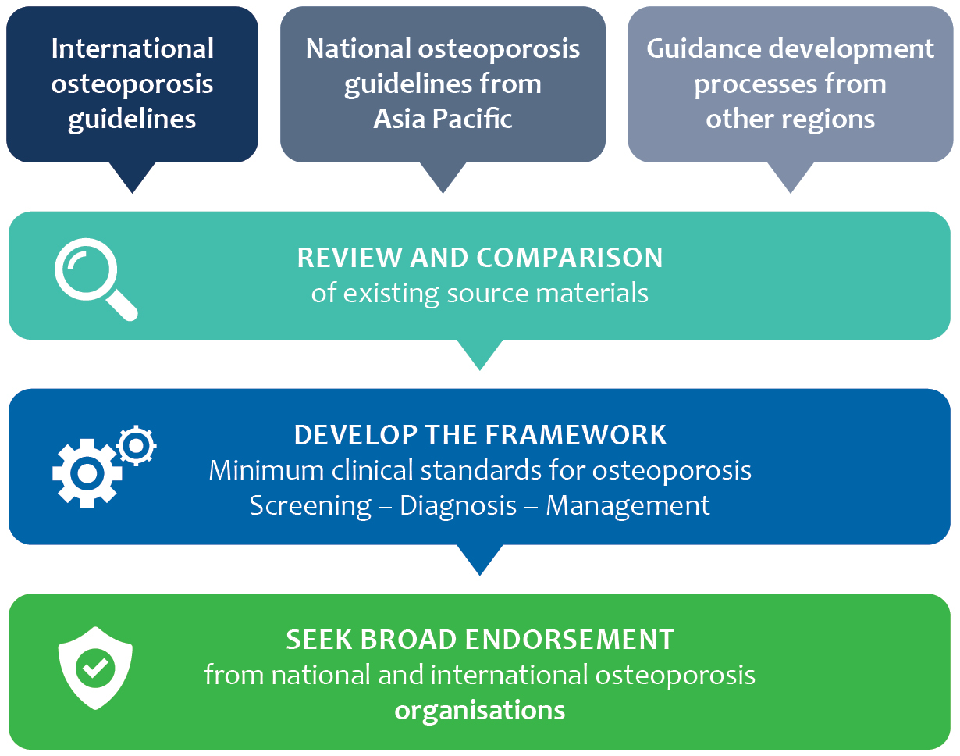
APCO Strategic priority 1: Clinical excellence
Develop and disseminate an evidence-based set of clinical standards of care (the Framework) for the screening, diagnosis and management of osteoporosis
Goal #1: During 2020, develop a pan-Asia Pacific framework with minimum clinical standards for the screening, diagnosis and management of osteoporosis for groups at high risk of fracture.
Goal #2: During 2020, publish the Framework in a peer-reviewed osteoporosis journal and maximise awareness of the Framework.
APCO Strategic Plan 2019–2022.
Notes:
Speaker notes:
Having identified the gaps in osteoporosis care, APCO’s first strategic priority was to develop clear and concise standards for the screening, diagnosis, and management of osteoporosis that are pan Asia-Pacific in their reach.
Once the Framework is published, APCO will seek broad endorsement from national and international osteoporosis organisations.

Slide 7
The Framework project
A two-step process:
1. Comparative analysis of osteoporosis guidelines in the Asia Pacific region
5IQ: Identification, investigation, information, intervention, integration, quality
2. Consensus process for developing the clinical care standards framework
4-round Delphi process
Chandran M, et al. Osteoporos Int 2021; online head of print. DOI: https://doi.org/10.1007/s00198-020-05742-0
Notes:
Speaker notes:
A framework of minimum clinical care standards (the Framework) was developed in two stages: (i) a detailed comparative analysis of osteoporosis clinical practice guidelines in the Asia-Pacific region, and (ii) a structured consensus process to draft the standards.

Slide 8
Comparative analysis of osteoporosis guidelines in the Asia Pacific
Survey of APCO members to identify national or regional clinical practice guidelines
Development of modified ‘5IQ’ template for standardized identification of guideline components
Data extraction (100 elements from each guideline)
18 Clinical guidelines identified from the Asia Pacific
(see next slide)
Analyzed for:
Newer guidelines (published 2015–2020)
Older guidelines (published before 2015)
Chandran M, et al. Osteoporos Int 2021; online head of print. DOI: https://doi.org/10.1007/s00198-020-05742-0
Notes:
Speaker notes:
Existing national or regional clinical practice guidelines and/or standards of care were identified through a survey among APCO members. A total of 18 clinical guidelines were identified (see slides 10 and 11).
A structured template was developed to facilitate standardized identification of guideline components. The template was based on the ‘5IQ’ model (as shown on slide), modifications of which have been used to develop clinical standards for fracture liaison services (FLSs) in Japan, New Zealand, and in the United Kingdom.¹⁻³
For each guideline, we identified the format in which the recommendations/information were provided and extracted details of these parameters. One-hundred data elements were extracted from each guideline.
References:
Arai H, et al. (2019) Clinical standards for fracture liaison services in Japan. Japan Osteoporosis Society and Fragility Fracture Network Japan, Tokyo
Osteoporosis New Zealand (2017) Clinical standards for fracture liaison services in New Zealand. Osteoporosis New Zealand, Wellington
Gittoes N, et al. (2015) Effective secondary prevention of fragility fractures: clinical standards for fracture liaison services. National Osteoporosis Society, Camerton.

Slide 9
Comparative analysis of osteoporosis guidelines in the Asia Pacific
Template parameters for data extraction based on ‘5IQ’
Guideline publication information | 8 elements
Case identification | 34 elements
Investigation | 21 elements
Information for patients | 5 elements
Interventions | 28 elements
Strategies for long-term management and integration of osteoporosis care into the health system | 2 elements
Strategies to promote the quality of clinical care | 2 elements
Chandran M, et al. Osteoporos Int 2021; online head of print. DOI: https://doi.org/10.1007/s00198-020-05742-0
Notes:
Speaker notes:
The template used for extracting data from clinical practice guidelines included the elements shown in the slide – for details, see Appendix 1 of the article.

Slide 10
Osteoporosis management clinical practice guidelines included in 5IQ analysis (1)
Country or region | Organization
Australia | Osteoporosis Australia & The Royal Australian College of General Practitioners
China | Osteoporosis and Bone Mineral Disease Branch of Chinese Medical Association
 | Osteoporosis Society of China & Association of Gerontology and Geriatrics
 | Osteoporosis Group, Orthopedic Branch, Chinese Medical Association
Hong Kong SAR | The Osteoporosis Society of Hong Kong
Chinese Taipei | Taiwanese Osteoporosis Association
India | Indian Menopause Society
 | Indian Society for Bone and Mineral Research
Indonesia | Indonesian Osteoporosis Association (Perhimpunan Osteoporosis Indonesia)
Japan | Japan Osteoporosis Society, The Japanese Society for Bone and Mineral Research & Japan Osteoporosis Foundation
Chandran M, et al. Osteoporos Int 2021; online head of print. DOI: https://doi.org/10.1007/s00198-020-05742-0
Notes:
Speaker notes:
The analysis included 18 guidelines from the following regions (also see next slide): Australia,¹ China (three guidelines),²⁻⁴ Chinese Taipei,⁵ Hong Kong Special Administrative Region of the People's Republic of China (SAR),⁶ India (two guidelines),^{7,8} Indonesia,⁹ Japan.¹⁰
References:
The Royal Australian College of General Practitioners, Osteoporosis Australia (2017) Osteoporosis prevention, diagnosis and management in postmenopausal women and men over 50 years of age. 2nd edition. RACGP, East Melbourne
Osteoporosis and Bone Mineral Disease Branch of Chinese Medical Association (2017) Guidelines for the diagnosis and treatment of primary osteoporosis (2017). Chin J Osteo Bone Miner Res 10:413-444
Workgroup of 2018 China Guideline for the Diagnosis and Treatment of Senile Osteoporosis, Osteoporosis Society of China Association of Gerontology and Geriatrics, Ma Y, et al. (2018) [2018 China guideline for the diagnosis and treatment of senile osteoporosis] [in Chinese]. Chin J Health Manage 12:484-509
Osteoporosis Group Orthopaedic Branch Chinese Medical Association, Liu Q, Cao L, et al. (2017) [Guidelines for the diagnosis and treatment of osteoporotic fractures] [in Chinese]. Chinese Journal of Orthopaedics 37:1-10
Huang Z, Fang Y, Wu Z, et al. (2017) 2017 Consensus and guidelines for the prevention and treatment of adult osteoporosis in Taiwan Taiwanese Osteoporosis Association, Taipei
OSHK Task Group for Formulation of OSHK Guideline for Clinical Management of Postmenopausal Osteoporosis in Hong Kong, Ip TP, Cheung SK, et al. (2013) The Osteoporosis Society of Hong Kong (OSHK): 2013 OSHK guideline for clinical management of postmenopausal osteoporosis in Hong Kong. Hong Kong Med J 19 Suppl 2:1-40
Singh M, Harinarayan CV, Marwah R, Sahay R, Kalra S, Babhulkar S (2020) Clinical practice guidelines on postmenopausal osteoporosis: an executive summary and recommendations - Update 2019. Indian Menopause Society, Hyderabad
Bhadada SK (2020) Indian Society for Bone and Mineral Research guidelines 2020. Indian Society for Bone and Mineral Research, New Delhi
Setyohadi B, Hutagalung EUHU, Frederik Adam JM, et al. (2012) Summary of the Indonesian guidelines for diagnosis and management of osteoporosis. JAFES 27:147
Orimo H (2015) [Japanese 2015 guidelines for the prevention and treatment of osteoporosis] [in Japanese]. Japan Osteoporosis Society, The Japanese Society for Bone and Mineral Research & Japan Osteoporosis Foundation, Tokyo

Slide 11
Osteoporosis management clinical practice guidelines included in 5IQ analysis (2)
Country or region | Organization
Malaysia | Malaysian Osteoporosis Society, Academy of Medicine & Ministry of Health Malaysia
Myanmar | Myanmar Society of Endocrinology and Metabolism
New Zealand | Osteoporosis New Zealand
Philippines | Osteoporosis Society of Philippines Foundation & Philippine Orthopedic Association
Singapore | Agency for Care Effectiveness, Ministry of Health Singapore
South Korea | Korean Society for Bone and Mineral Research
Thailand | Thai Osteoporosis Foundation
Vietnam | Vietnam Rheumatology Association
Chandran M, et al. Osteoporos Int 2021; online head of print. DOI: https://doi.org/10.1007/s00198-020-05742-0
Notes:
Speaker notes:
As well as from Malaysia,¹ Myanmar,² New Zealand,³ the Philippines,⁴ Singapore,⁵ South Korea,⁶ Thailand,⁷ and Vietnam.⁸
Of these, 14 (78%) were published between 2015 and 2020.
Two-thirds of the guidelines did not specify a date for planned revision.
Six stated that an update within 3–5 years was planned.
References:
Chan SP, Yeap SS, Lee EGM, Chee W, Hew FL, Lee JK, Lim HH, Damodaran P, Mumtaz M (2015) Clinical guidance on management of osteoporosis, 2nd edn. Malaysian Osteoporosis Society, Academy of Medicine & Ministry of Health, Malaysia, Petaling Jaya
Latt TS, Aye TT, Ko K, Myint T, Hliang NN, Thaung M, Chit TT (2012) Myanmar clinical practice guidelines for osteoporosis. JAFES 27:151-155
Gilchrist N, Reid IR, Sankaran S, Kim D, Drewry A, Toop L, McClure F (2017) Guidance on the diagnosis and management of osteoporosis in New Zealand. Osteoporosis New Zealand, Wellington
Li-Yu J, Perez EC, Canete A, Bonifacio L, Llamado LQ, Martinez R, Lanzon A, Sison M, Osteoporosis Society of Philippines Foundation Inc, Philippine Orthopedic Association Clinical Practice Guidelines Task Force Committee on Osteoporosis (2011) Consensus statements on osteoporosis diagnosis, prevention, and management in the Philippines. Int J Rheum Dis 14:223-238
Chandran M, Ang SB, Au L, et al. (2018) Appropriate care guide: osteoporosis identification and management in primary care. Ministry of Health, Singapore
Yoon HG, Jung HY, Yoon BG (2019) [KSBMR physician's guide for osteoporosis] [in Korean]. Korean Society for Bone and Mineral Research, Seoul
Songpatanasilp T, Sritara C, Kittisomprayoonkul W, et al. (2016) Thai Osteoporosis Foundation (TOPF) position statements on management of osteoporosis. Osteoporos Sarcopenia 2:191-207
Vietnam Rheumatology Association (2016) [Guidelines for the diagnosis and treatment of osteoporosis] [in Vietnamese]. Vietnam Rheumatology Association, Hanoi

Slide 12
5IQ analysis results
Total 18 guidelines were included (11 in English). Other languages included:
Chinese (4 guidelines)
Japanese (1 guideline)
Korean (1 guideline)
Vietnamese (1 guideline)
Marked heterogeneity, notably in guidance on:
risk factors
use of biochemical markers
self-care information for patients
indications for osteoporosis treatment
use of fracture risk assessment tools
protocols for monitoring treatment.
Minimal guidance on:
long-term management plans
strategies and systems for clinical quality improvement.
Chandran M, et al. Osteoporos Int 2021; online head of print. DOI: https://doi.org/10.1007/s00198-020-05742-0
Notes:
Speaker notes:
Eleven of the guidelines were available in English.
The 5IQ analysis confirmed previous anecdotal findings of marked heterogeneity among clinical practice guidelines for osteoporosis in the Asia-Pacific region – notably in guidance on risk factors, the use of biochemical bone turnover markers, self-care information for patients, indications for osteoporosis treatment, the use of fracture risk assessment tools, and protocols for monitoring treatment.
Minimal guidance was provided on long-term management plans.
Few mentioned strategies and systems for ensuring clinical quality improvement.
The 5IQ analysis of the multiple clinical practice guidelines on osteoporosis from Asia Pacific countries and regions confirmed APCO’s understanding, based on previous anecdotal reports, that existing guidelines were markedly heterogeneous in terms of their scope and recommendations.
The findings enabled APCO members to prioritize and select elements through the Delphi consensus method – see next section.

Slide 13
Consensus process for developing the clinical care standards framework
The Delphi technique is well suited for consensus-building; it uses a series of questionnaires delivered in multiple iterations to collect data from a panel of participants
The Framework
Round 1
Round 2
Round 3
Round 4
32 questions under 3 domains:
Domain 1: Notable findings from the 5IQ Comparative analysis of osteoporosis clinical guidelines
Domain 2: How should the Framework be structured?
Domain 3: What clinical standards are required?
16 clinical standards drafted:
Levels of agreement
Consensus if ‘strongly agree’ + ‘agree’ ≥75% of respondents
16 clinical standards refined:
Wording of clinical standards and levels of attainment amended based on Round 2
Consensus if ‘yes’ response to proposed rewording by ≥75% of respondents
16 clinical standards finalised:
Rewording of clinical standards and levels of attainment amended for clarity and precision
Sent to APCO members who had participated in at least one Delphi round
Instructed to contact Chairperson if any objections
Chandran M, et al. Osteoporos Int 2021; online head of print. DOI: https://doi.org/10.1007/s00198-020-05742-0
Notes:
Speaker notes:
A four-round Delphi process was adopted to develop standards of care for osteoporosis risk assessment, diagnosis and management that are appropriate for the Asia Pacific region.
This structured approach ensures that the opinions of participants are equally considered, and it is particularly useful for geographically diverse groups like APCO.
The Delphi process was conducted through online questionnaires.
Round 1
APCO members were invited to determine which aspects of care required clinical standards to be developed, based on a list informed by the findings of the 5IQ comparative analysis. The questionnaire included 32 questions under three domains (see Appendix 2 of article):
Domain 1: What are the notable findings from the 5IQ Comparative analysis of osteoporosis clinical guidelines from across the Asia Pacific region? Participants were referred to specific sections within the analysis report and invited to identify important findings.
Domain 2: How should the Framework be structured? Participants were asked to indicate how the Framework should be structured, including whether levels of attainment should be included for clinical standards to serve as potential quality performance indicators.
Domain 3: What clinical standards are required? For each of 21 key elements identified in the 5IQ analysis of Asia-Pacific clinical practice guidelines, participants were asked their opinion on the importance of its inclusion as a clinical standard (5-point scale from ‘extremely important’ to ‘not at all important’, with optional free text comments).
Consensus was defined as a ranking of ‘extremely important’ or ‘very important’ by at least 75% of respondents. Participants were also invited to make any general comments on development of the Framework.
Round 2
Members were asked to express their agreement (or not) with the wording of 16 draft clinical standards, of which several included proposed wording on levels of attainment (five-point scale from ‘strongly agree’ to ‘strongly disagree’).
For each draft standard, members were also invited to propose alternative wording or make comments.
Consensus was defined as a ranking of ‘strongly agree’ or ‘agree’ by at least 75% of respondents.
Round 3
The wording of clinical standards and levels of attainment was amended, based on the results of Round 2.
APCO members were invited to approve amendments (yes/no options).
Consensus was defined as a ‘yes’ response to a proposed rewording by at least 75% of respondents.
Round 4
A fourth round was conducted after some of the standards and levels of attainment were again reworded for clarity and precision without changing their intent.
The minor amendments to the wording of the standards, with commentary itemizing each change, were sent to the APCO members who had participated in one or more of the previous Delphi rounds.
Members were instructed to reply to the Chairperson by a stipulated date if they had any objection to the rewording of the standards.

Slide 14
Outcomes of the Delphi process: Round 1
29 out of 38 APCO members participated in one or more rounds of the Delphi process
Component | Consensus (%)*
IDENTIFICATION
Fragility fracture | Yes (100%)
Risk factors for osteoporosis | Yes (92%)
Medicines associated with bone loss/fracture risk | Yes (88%)
Medical conditions associated with bone loss/fracture risk | Yes (84%)
Component | Consensus (%)*
INVESTIGATION
Biochemistry | No
BMD testing | No
Risk assessment tools | Yes (84%)
Vertebral fracture assessment | Yes (79%)
Falls risk assessment | Yes (88%)
Specialist referral | No
Information for patients | Yes (84%)
*% rating as extremely or very important (i.e. ≥75%)
Chandran M, et al. Osteoporos Int 2021; online head of print. DOI: https://doi.org/10.1007/s00198-020-05742-0
Notes:
Speaker notes:
At the end of Round 1 of the Delphi process, consensus was reached on the inclusion of clinical standards on the components shown on this and the next slide (i.e. those with ≥ 75% rated its inclusion as important or extremely important).

Slide 15
Outcomes of the Delphi process: Round 1
Component | Consensus (%)*
INTERVENTION (Indications for initiating osteoporosis treatment)
Hip fracture | Yes (96%)
Vertebral fracture | Yes (96%)
Non-hip non-vertebral fracture | Yes (80%)
BMD T-score ≤ –2.5 SD Osteopenia + FRAX® ≥ 3% hip or ≥20% MOF Osteopenia + RFs or eligible by OSTA or SCORE; Osteopenia + ≥ 10 years post menopause FRAX® or Garvan ≥ 3% hip or ≥20% MOF Eligible by OSTA, MORES or SCORE QCT Height loss >4 cm Androgen deprivation therapy Aromatase inhibitor treatment Glucocorticoid treatment Country-specific thresholds | No
Component | Consensus (%)*
INTERVENTION
Pharmacological | Yes (88%)
Non-pharmacological | Yes (80%)
Side-effects | Yes (84%)
Monitoring effect | Yes (88%)
Duration | Yes (84%)
Adherence | Yes (80%)
Falls programs | No
INTEGRATION
Long-term management plans | Yes (80%)
QUALITY
Adherence to guideline-based care | Yes (88%)
BMD: bone mineral density; MORES: Male Osteoporosis Risk Estimation Score; OSTA: Self-Assessment Tool for Asians; SCORE: Simple Calculated Osteoporosis Risk Estimation; QCT: quantitative computed tomography
*% rating as extremely or very important (i.e. ≥75%)
Chandran M, et al. Osteoporos Int 2021; online head of print. DOI: https://doi.org/10.1007/s00198-020-05742-0
Notes:
Speaker notes:
Although the initial intention was to draft levels of attainment for each standard, only a few standards proved amenable to this approach after collating respondents’ comments on priority rankings and levels of attainment.
Levels of attainment were therefore drafted initially for five standards viz for those on:
identification of fragility fractures
identification of patients with common risk factors
investigation of vertebral fractures
assessment of adherence to pharmacological treatment
quality metrics to assess clinical adherence to guidelines.
Each of these five standards had three levels of attainment, stratified according to degree of difficulty or feasibility of implementation.

Slide 16
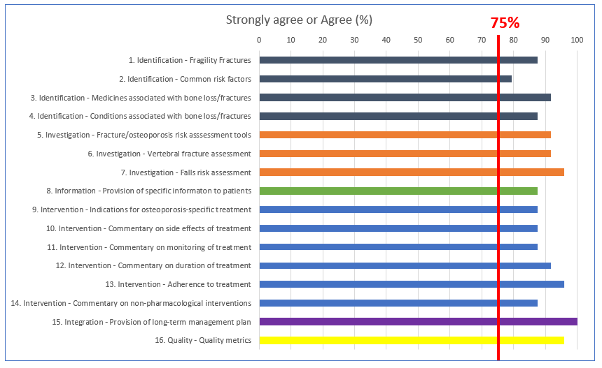
Outcomes of the Delphi process: Round 2
Chandran M, et al. Osteoporos Int 2021; online head of print. DOI: https://doi.org/10.1007/s00198-020-05742-0
Notes:
Speaker notes:
At the end of Round 2, consensus was reached (i.e. ≥75% of respondents strongly agreed or agreed) on the wording of all 16 standards (see figure).
Agreement was unanimous or nearly so (>90% agreement) for the wording of draft standards on:
Proactive case identification based on medicines associated with bone loss/increased fracture risk
The use of country-specific fracture risk assessment tools, vertebral fracture assessment, and falls risk assessment
Duration of pharmacological treatment and adherence to pharmacological treatment
Long-term management plans
Metrics for adherence to guidelines.
Diversity of opinion was greatest for the wording of the draft standard on proactive case identification based on common risk factors, although consensus was reached.
The volume of comments (excluding minor editing suggestions) was highest for the standards on, medicines associated with risk, assessment of vertebral fractures, intervention thresholds for osteoporosis-specific therapies, and assessment of adherence to pharmacological therapies.

Slide 17
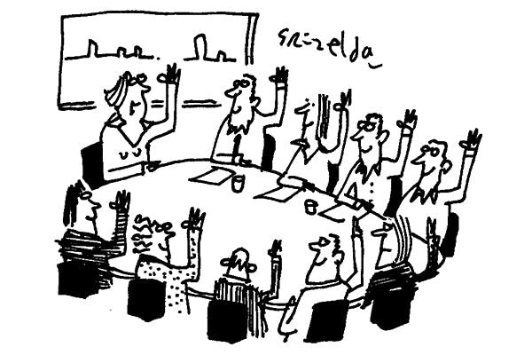
Outcomes of the Delphi process: Rounds 3 & 4
Round 3:
Consensus was achieved on all the proposed amendments
At the end of Round 3, consensus had been reached on the final Framework of minimum clinical standards
Round 4:
No objections to the minor amendments proposed to improve clarity and precision of the wording of some of the standards
Chandran M, et al. Osteoporos Int 2021; online head of print. DOI: https://doi.org/10.1007/s00198-020-05742-0
Notes:
Speaker notes:
At the end of Round 3, consensus was achieved on all the proposed amendments, involving six standards, and levels of attainment for two standards.
Consensus had been reached on the final Framework of minimum clinical standards.
At Round 4, there were no objections to the minor amendments proposed to improve clarity and precision of the wording of some of the standards.

Slide 18
The APCO Framework

Slide 19
Clinical standard 1
Men and women who sustain a fragility fracture should be systematically and proactively identified to undergo assessment of bone health and, where appropriate, falls risk.
Levels of attainment for clinical standard 1:
Level 1: Individuals who sustain hip fractures should be identified.
Level 2: Individuals who sustain hip and/or clinical vertebral fractures should be identified.
Level 3: Individuals who sustain hip, clinical and/or morphometric vertebral, and/or non-hip, non-vertebral major osteoporotic fractures should be identified.
Chandran M, et al. Osteoporos Int 2021; online head of print. DOI: https://doi.org/10.1007/s00198-020-05742-0
Notes:
Speaker notes:
Clinical standard as shown on the slide

Slide 20
Clinical standard 2
Clinical standard 3
Men and women with common risk factors for osteoporosis should be proactively identified to undergo assessment of bone health and, where appropriate, falls risk.
A sex-specific age threshold for assessment should be determined for each country or region and should be included in new or revised osteoporosis clinical guidelines.
Men and women who take medicines that are associated with bone loss and/or increased fracture risk should be proactively identified to undergo assessment of bone health and, where appropriate, falls risk.
A commentary should be included in new or revised osteoporosis clinical guidelines to highlight commonly used medicines that are associated with bone loss and/or increased fracture risk.
Chandran M, et al. Osteoporos Int 2021; online head of print. DOI: https://doi.org/10.1007/s00198-020-05742-0
Notes:
Speaker notes:
Clinical standards as shown on the slide

Slide 21
Clinical standard 4
Men and women who have conditions associated with bone loss and/or increased fracture risk should be proactively identified to undergo assessment of bone health.
A commentary should be included in new or revised osteoporosis clinical guidelines to highlight common prevalent conditions in the country or region.
Chandran M, et al. Osteoporos Int 2021; online head of print. DOI: https://doi.org/10.1007/s00198-020-05742-0
Notes:
Speaker notes:
Clinical standard as shown on the slide

Slide 22
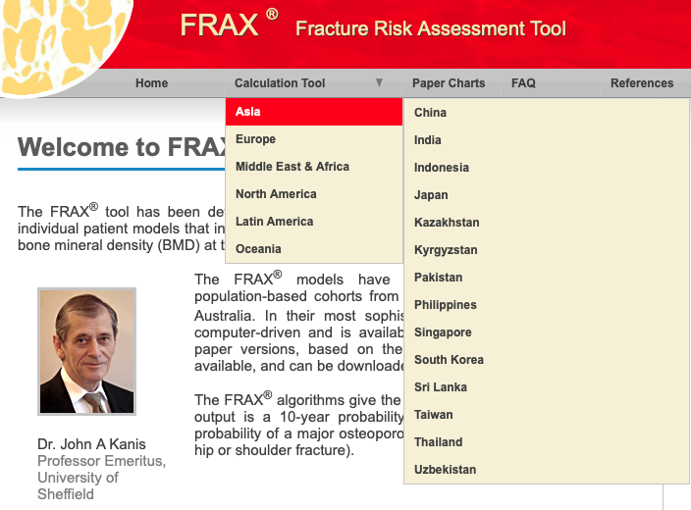
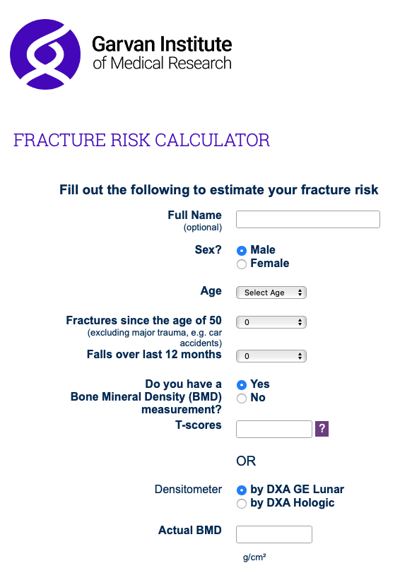
Clinical standard 5
The use of country-specific (if available) fracture risk assessment tools (e.g. FRAX®, Garvan, etc.) or osteoporosis screening tools (e.g. OSTA) should be a standard component of investigation of an individual’s bone health and prediction of future fracture risk and/or osteoporosis risk.
Chandran M, et al. Osteoporos Int 2021; online head of print. DOI: https://doi.org/10.1007/s00198-020-05742-0
Notes:
Speaker notes:
Clinical standard as shown on the slide

Slide 23
Clinical standard 6
Assessment for presence of vertebral fracture(s) either by X-ray (or other radiological investigations such as CT or MRI) or DXA-based vertebral fracture assessment (VFA) should be a standard component of investigation of osteoporosis and prediction of future fracture risk.
Levels of attainment for clinical standard 6:
Level 1: Individuals presenting with clinical vertebral fractures should undergo assessment for osteoporosis.
Level 2: Individuals with incidentally detected vertebral fractures on X-ray and/or other radiological investigations should be assessed for osteoporosis.
Level 3: Individuals being assessed for osteoporosis should undergo spinal imaging with X-ray or other appropriate radiological modalities, or with DXA-based VFA.
Chandran M, et al. Osteoporos Int 2021; online head of print. DOI: https://doi.org/10.1007/s00198-020-05742-0
Notes:
Speaker notes:
Clinical standard as shown on the slide

Slide 24
Clinical standard 7
Clinical standard 8
A falls risk assessment should be a standard component of investigation of an individual’s future fracture risk.
In order to engage individuals in their own care, information should be provided on calcium and vitamin D intake, sun exposure, exercise, and the relationship between osteoporosis and fracture risk.
Chandran M, et al. Osteoporos Int 2021; online head of print. DOI: https://doi.org/10.1007/s00198-020-05742-0
Notes:
Speaker notes:
Clinical standards as shown on the slide

Slide 25
Clinical standard 9
Clinical standard 10
The decision to treat with osteoporosis-specific therapies and the choice of therapy should be informed as much as possible by country‑specific and cost‑effective intervention thresholds.
Intervention thresholds that can be considered include:
History of fragility fracture
BMD T-Score ≤ –2.5 S.D.
High fracture risk as assessed by country-specific intervention thresholds.
New or revised osteoporosis clinical guidelines should include a commentary on the common side effects of pharmacological treatments that are recommended in the guidelines.
Chandran M, et al. Osteoporos Int 2021; online head of print. DOI: https://doi.org/10.1007/s00198-020-05742-0
Notes:
Speaker notes:
Clinical standards as shown on the slide

Slide 26
Clinical standard 11
Clinical standard 12
New or revised osteoporosis clinical guidelines should provide a commentary on monitoring of pharmacological treatments.
This could include, e.g. the role of biochemical markers of bone turnover and bone mineral density measurement.
New or revised osteoporosis clinical guidelines should provide a commentary on the duration of pharmacological treatments that are recommended in the guidelines.
This should include a discussion on the appropriate order of sequential treatment with available therapies and the role of ‘drug holidays’.
Chandran M, et al. Osteoporos Int 2021; online head of print. DOI: https://doi.org/10.1007/s00198-020-05742-0
Notes:
Speaker notes:
Clinical standards as shown on the slide

Slide 27
Clinical standard 13
Assessment of adherence to pharmacological treatments that are recommended in new or revised osteoporosis clinical guidelines should be undertaken on an ongoing basis after initiation of therapy, and appropriate corrective action be taken if treated individuals have become non-adherent.
Chandran M, et al. Osteoporos Int 2021; online head of print. DOI: https://doi.org/10.1007/s00198-020-05742-0
Notes:
Speaker notes:
Clinical standard as shown on the slide

Slide 28
Clinical standard 14
New and revised osteoporosis clinical guidelines should provide a commentary on recommended non-pharmacological interventions, such as exercise and nutrition (including dietary calcium intake) and other non-pharmacological interventions (e.g. hip protectors).
Clinical standard 15
In collaboration with the patient, the treating clinician (hospital specialist and/or primary care provider) should develop a long-term management plan, that, provides recommendations on pharmacological and non-pharmacological interventions to improve bone health and, where appropriate, measures to reduce falls risk.
Chandran M, et al. Osteoporos Int 2021; online head of print. DOI: https://doi.org/10.1007/s00198-020-05742-0
Notes:
Speaker notes:
Clinical standards as shown on the slide

Slide 29
Clinical standard 16
New or revised osteoporosis clinical guidelines should provide a commentary on what quality metrics should be in place to assess adherence with guideline‑based care.
Levels of attainment for clinical standard 16:
Level 1: Conduct a local ‘pathfinder audit’ in a hospital or primary care practice to assess adherence to APCO Framework Clinical Standards 1–9, 13 and 15.
Level 2: Contribute to a local fracture/osteoporosis registry.
Level 3: Contribute to a fracture/osteoporosis registry for your country or region.
Chandran M, et al. Osteoporos Int 2021; online head of print. DOI: https://doi.org/10.1007/s00198-020-05742-0
Notes:
Speaker notes:
Clinical standard as shown on the slide

Slide 30
Application of the Framework to clinical practice guidelines
APCO’s goals:¹
All new and revised osteoporosis guidelines in Asia Pacific to:
Be consistent with scope proposed in the Framework
APCO members to:
Identify opportunities to share the Framework with colleagues and organizations involved in clinical practice guideline development
Facilitate adoption of the clinical standards at a local, national and regional level
Promote the standards of care recommended in the Framework
Recommend local benchmarking against the standards recommended in the Framework
APCO’s vision:
To reduce the burden of osteoporosis and fragility fractures in the Asia Pacific region²
1. Chandran et al. Osteoporos Int 2021; online head of print. DOI: https://doi.org/10.1007/s00198-020-05742-0; 2. APCO Strategic Plan 2019–2022.
Notes:
Speaker notes:
Clinicians need information that is clear and readily accessible.
Osteoporosis guidelines should clearly articulate which individuals should be identified for assessment, the investigations that should be offered, appropriate indications for treatment, the pharmacological treatments and other interventions that should be offered to specific patient groups, information on self-management that should be provided to patients, how the levels of healthcare systems should be integrated to ensure seamless care, and how the quality of osteoporosis healthcare services should be monitored and improved.
APCO’s goal is that all new or revised clinical practice guidelines for prevention, diagnosis, and management of osteoporosis in the Asia-Pacific region will:
be consistent with the scope proposed in the Framework
promote the standards of care recommended in the Framework
recommend local benchmarking against the standards recommended in the Framework.
To achieve this, APCO members will identify opportunities in their individual countries and regions to share the Framework with colleagues and organizations involved in clinical practice guideline development.
The clinical standards will be distributed in a modular format that should allow easy adoption at the individual health care facility, national or regional level.
Application of the Framework and achievement of the above goals will help bring APCO’s vision to fruition in the Asia Pacific region.

Slide 31
THANK YOU

